Slide 1

Engineering Education with Extended Reality (XR)
Prof. Aveek Dutta, Department of Electrical & Computer Engineering
Joren Cruz, Diego Tapia, Daniel Wang
COLLEGE OF
NANOTECHNOLOGY,
SCIENCE, AND ENGINEERING
UNIVERSITY AT ALBANY | STATE UNIVERSITY OF NEW YORK

Slide 2
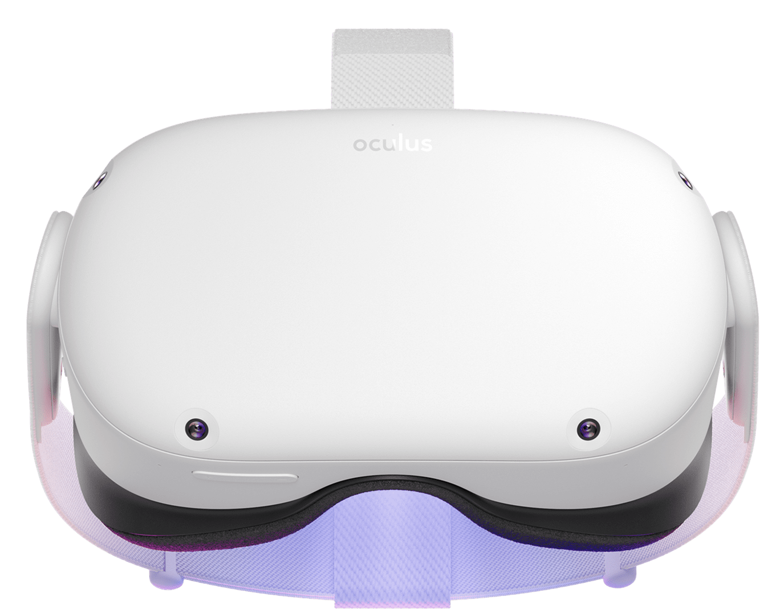
Introduction
COVID-era highlights the challenge of remote education
Piloting UAlbany’s first XR Lab
Immersive and Experiential Learning
XR FALL 2023
Notes:
Wang:
*One of the challenges that has been identified during the COVID-era is teaching courses that have mandatory lab components. In such cases remote teaching and learning is a challenge.
*In an effort to integrate XR into laboratory-oriented classes, we need to develop a VR/AR learning platform for fundamental classes within the ECE curriculum.
Lightning notes:
Our main objective is to support the idea that “everyone learns differently”. With the implementation of VR, we hope to create a fun and interactive learning tool that supplies fellow electrical engineers with a new method of gaining knowledge and learning new techniques, which can assist in classroom settings, and perhaps even workplace environments​

Slide 3
Background and Context
Problem Statement
Methodology
Key System Requirements
Logical Design
Physical Design
System Demonstration
Limitations
Future Work
Individual Contributions
Questions
Agenda
Notes:
Wang:
Brief statement on each*??

Slide 4
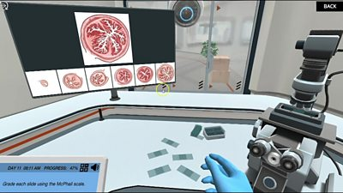
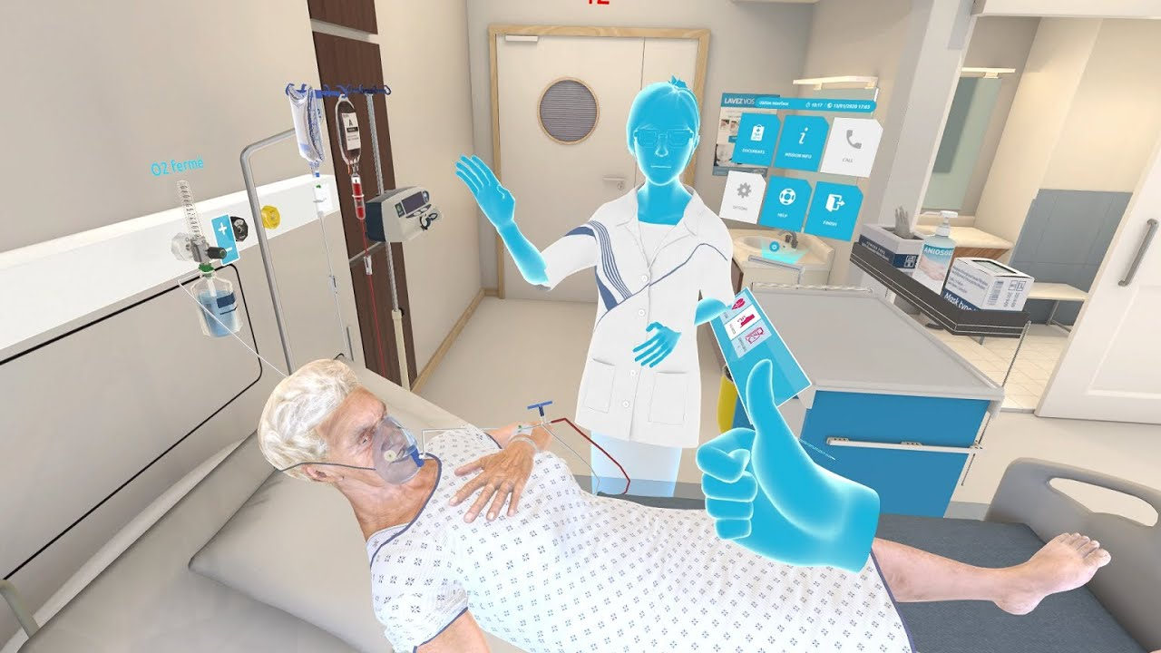
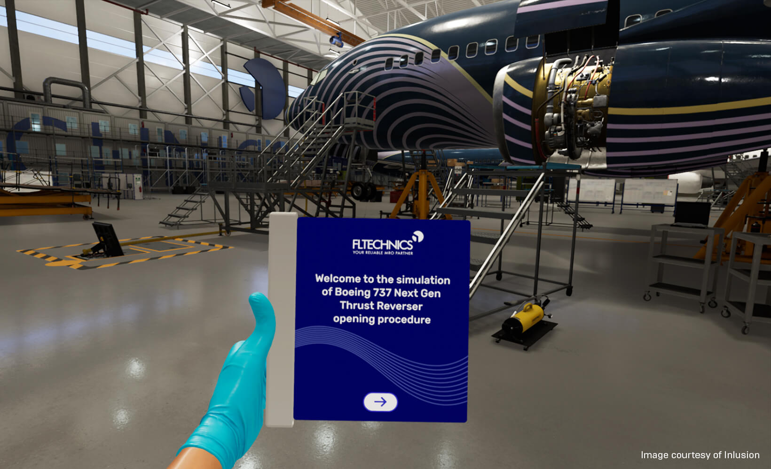
Background and Context
Revolutionary
Applications
Evolving landscape of education and technological advancements
Effective in other STEM fields
Notes:
Wang:
Cruz:
Lightning Notes:
This concept of this idea was given to us by our stakeholder, Professor Dutta. From his suggestions, we were able to hone in on wanting to develop in VR. The reason for picking VR over AR is primarily due to the fact that there are many other work environments in which it has already become a reliable and standard method of learning and practicing. Examples of such workplaces include STEM laboratory research, surgery simulations, patient care procedures, and aircraft maintenance engineering
XR is a recent and rapidly growing technology that has now opened new options and possibilities for all, from educators to learners. For our case we decided to work a lot closer with VR rather than AR, due heavily to the more widespread resources as well as its proven effectiveness in other STEM related applications, such as lab research, surgery simulations, patient care, and aircraft maintenance engineering. Given its revolutionary nature, we hope the same effects will occur in electrical engineering.

Slide 5



Problem Statement
HANDS-ON
REMOTE LEARNING
Learning through experiment
Mandatory lab components
Notes:
Wang:
Hands-on: A big part of the higher education experience in the field of engineering is the hands-on component and learning through experiment
Remote Learning: teaching courses that have mandatory laboratory components. In such cases remote teaching and learning is a challenge
Old:
Remote teaching and learning is a challenge as we have learned from the pandemic era
XR is envisioned as a key component of experiential learning

Slide 6
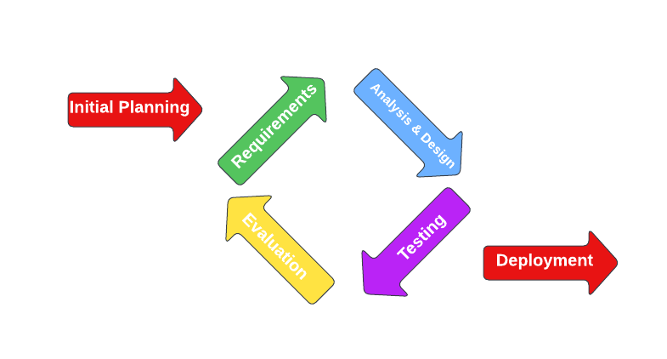
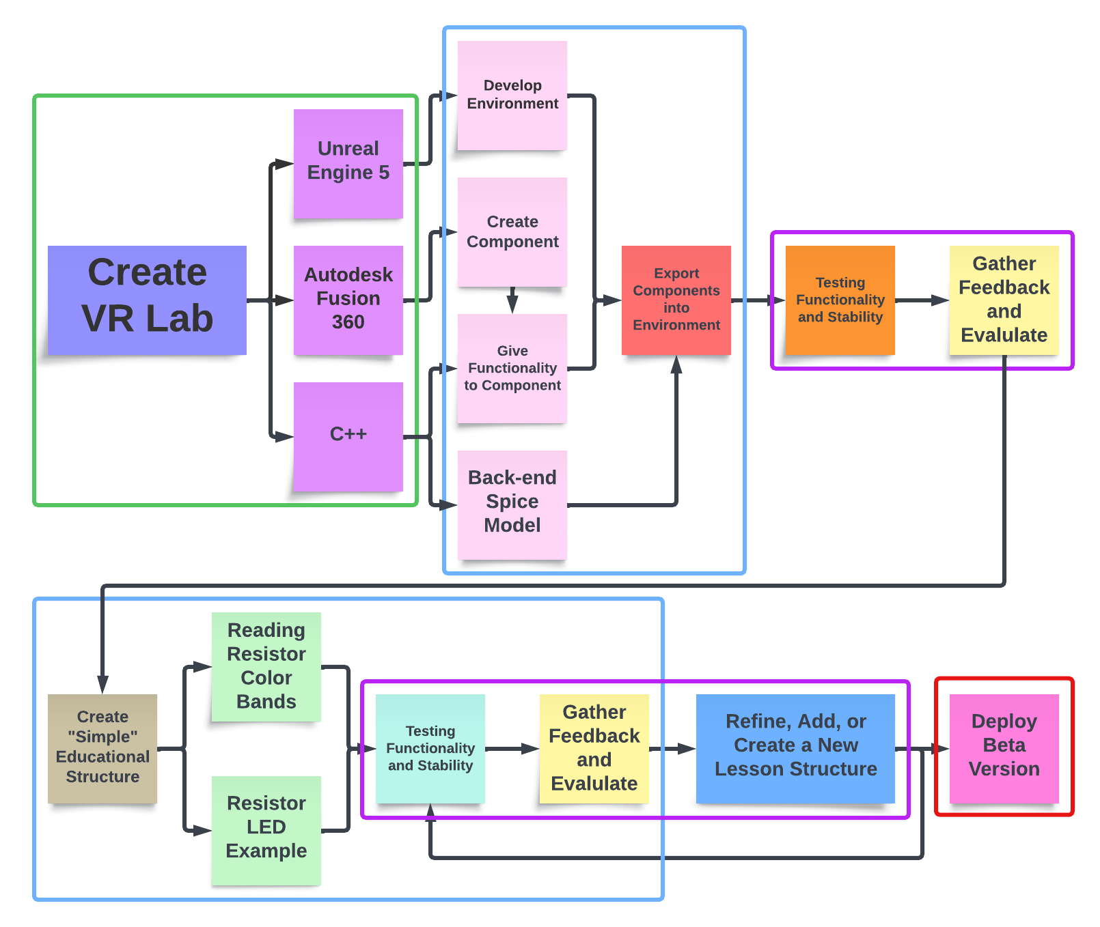
Methodology

Slide 7
01
02
03
Key System Requirements
Logical Design
Physical Design

Slide 8
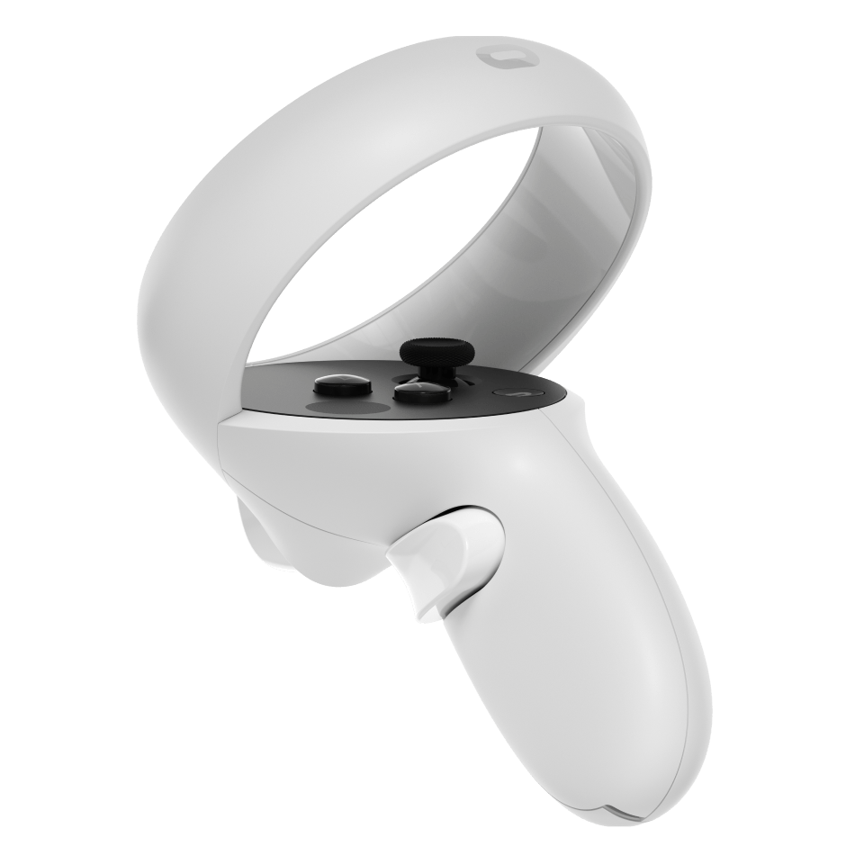
01 Key System Requirements
Functional Requirements
User Interactions – Intuitive Controls
Simulation Mechanics – Object Interactions
Environment Progression – Lessons
Optimization/Monitoring – Optimize Assets
Non-Functional Requirements
Performance – Convenience
Compatibility – Hardware and Platforms
Reliability – Stability
Notes:
Wang*
Motion Controls: Specify how users will interact with the VR environment using motion controllers, gestures, or other input devices.
Object Interactions: Define how users can interact with objects within the VR environment, including picking up, manipulating, and using items.
Interactive Elements: Define interactive elements such as puzzles, and dynamic objects.
Lessons – progress through the curriculum/labs as lessons
Loading Strategies: Define how assets will be loaded to minimize latency and loading times.
Testing and Quality Assurance:
Test Cases: Specify test cases and scenarios to ensure the stability and functionality of the VR game.
Latency: Define the maximum acceptable delay between user input and system response (e.g., less than 20 milliseconds).
Loading Times: Set expectations for how quickly the game should load between scenes or levels.
Compatibility:
Hardware Compatibility: Specify the VR hardware devices and platforms the game should support (e.g., Oculus Rift, HTC Vive, PlayStation VR).
Stability: Define acceptable downtime and system stability requirements to ensure a reliable gaming experience.
Error Handling: Specify how errors and exceptions should be handled to minimize disruptions for the player.

Slide 9
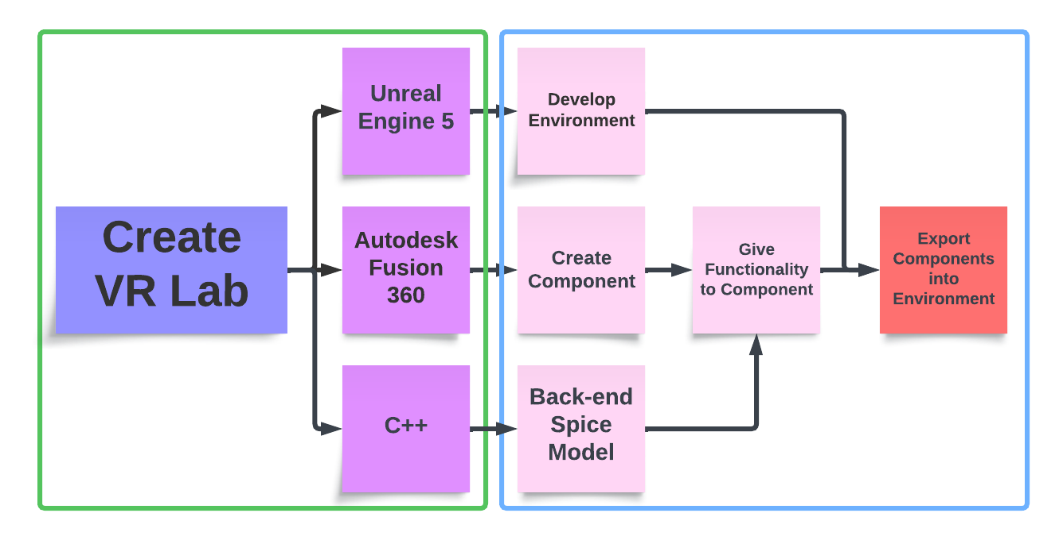
02 Logical Design
Design Concept
Components
Relationships
Notes:
Design Concept: Explain the overall concept of your logical design. This might include abstract representations, flowcharts, or diagrams.
Components: Outline the main components or elements of your design.
Relationships: Describe the relationships between these components. How do they interact with each other? What functions do they serve?
Lightning:
Design Concept
We are designing a virtual lab in which an individual can manipulate and use electrical components to make simple circuits.
Components
Unreal Engine 5, Fusion360, Blender, C++
Relationships
Design, Add Functionality, Host as Workspace
Advantages
Hands-on and Risk Free
Remote Accessibility
Considerations or Constraints
Technical Expertise – VR development, 3D modeling
User Experience - Accommodate users

Slide 10




03 Physical Design
Alternatives
Justification
Implementation Plan
System Components
Meta Quest 2
Unreal Engine 5
Fusion 360
Mixed Reality
AR
Hand Tracking
Documentation
Simplistic
Realistic
Piecewise
Constant Revision
Documentation
Notes:
Lightning:
System Components
Meta Quest 2
Alternatives
Augmented Reality/QR codes
Circuit Board Scanning Analysis
Justifications
QR was too simple
AR had less resources than VR
Virtual Learning had a larger scope

Slide 11
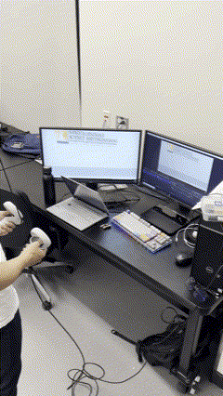
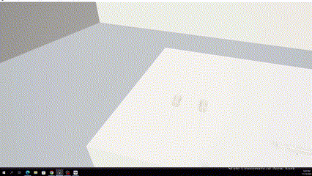
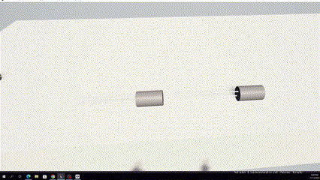
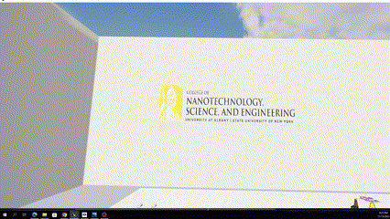
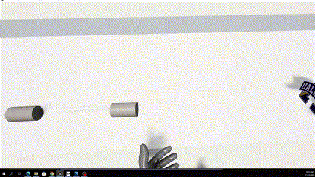
System Demonstration

Slide 12
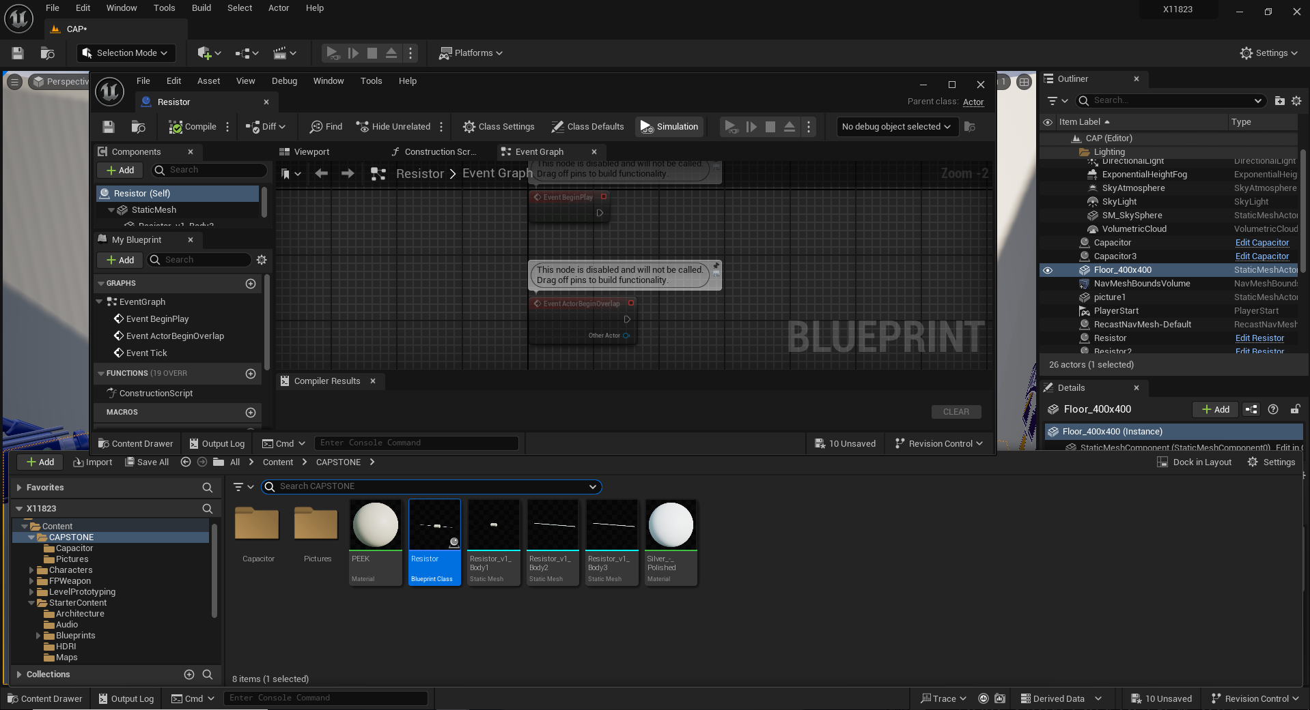

Limitations
Hardware:
Processing Power
Software:
High Learning Curve
Notes:
Learning Curve
The applications we are using to develop prove to be very versatile and customizable, however are difficult to grasp conceptually

Slide 13
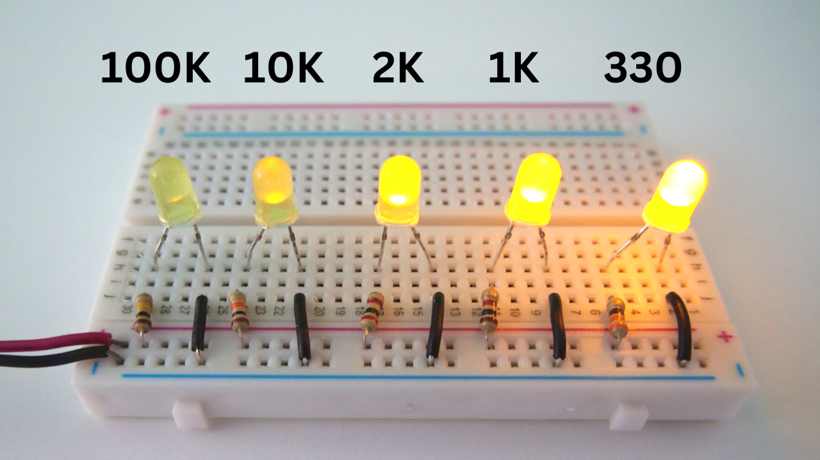
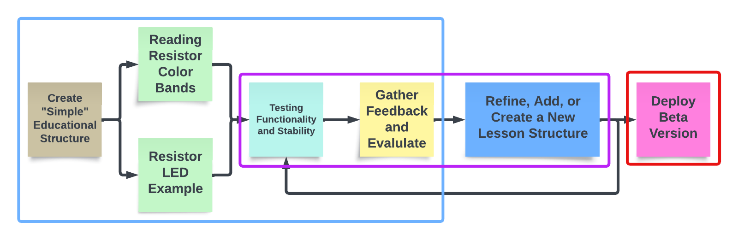
Recommendations for Future Work
Spring Plans
Future Work
- More Structural Lessons
- Deploy Beta
Notes:
Future Work: Expand into other areas of ECE (training)
Recommendations: Augmented Reality, Extended Reality
In regards to our future work, we are currently in the midst of module 4, attempting to develop a

Slide 14

Individual Contributions
Joren Cruz
Support Roles: Archivist, Scheduler
Most Significant Contribution: GitHub Repository, Documentation, Unreal Research
Diego Tapia
Support Roles: Point of Contact
Most Significant Contribution: Documentation, Skeleton Assets
Daniel Wang
Support Roles: Editor, Treasurer
Most Significant Contribution: Environment Development, GitHub Repository, Diagrams, and Documentation​

Slide 15
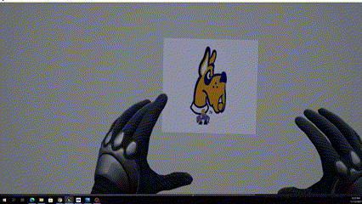
Thank You!

Slide 16
Questions?

Slide 17
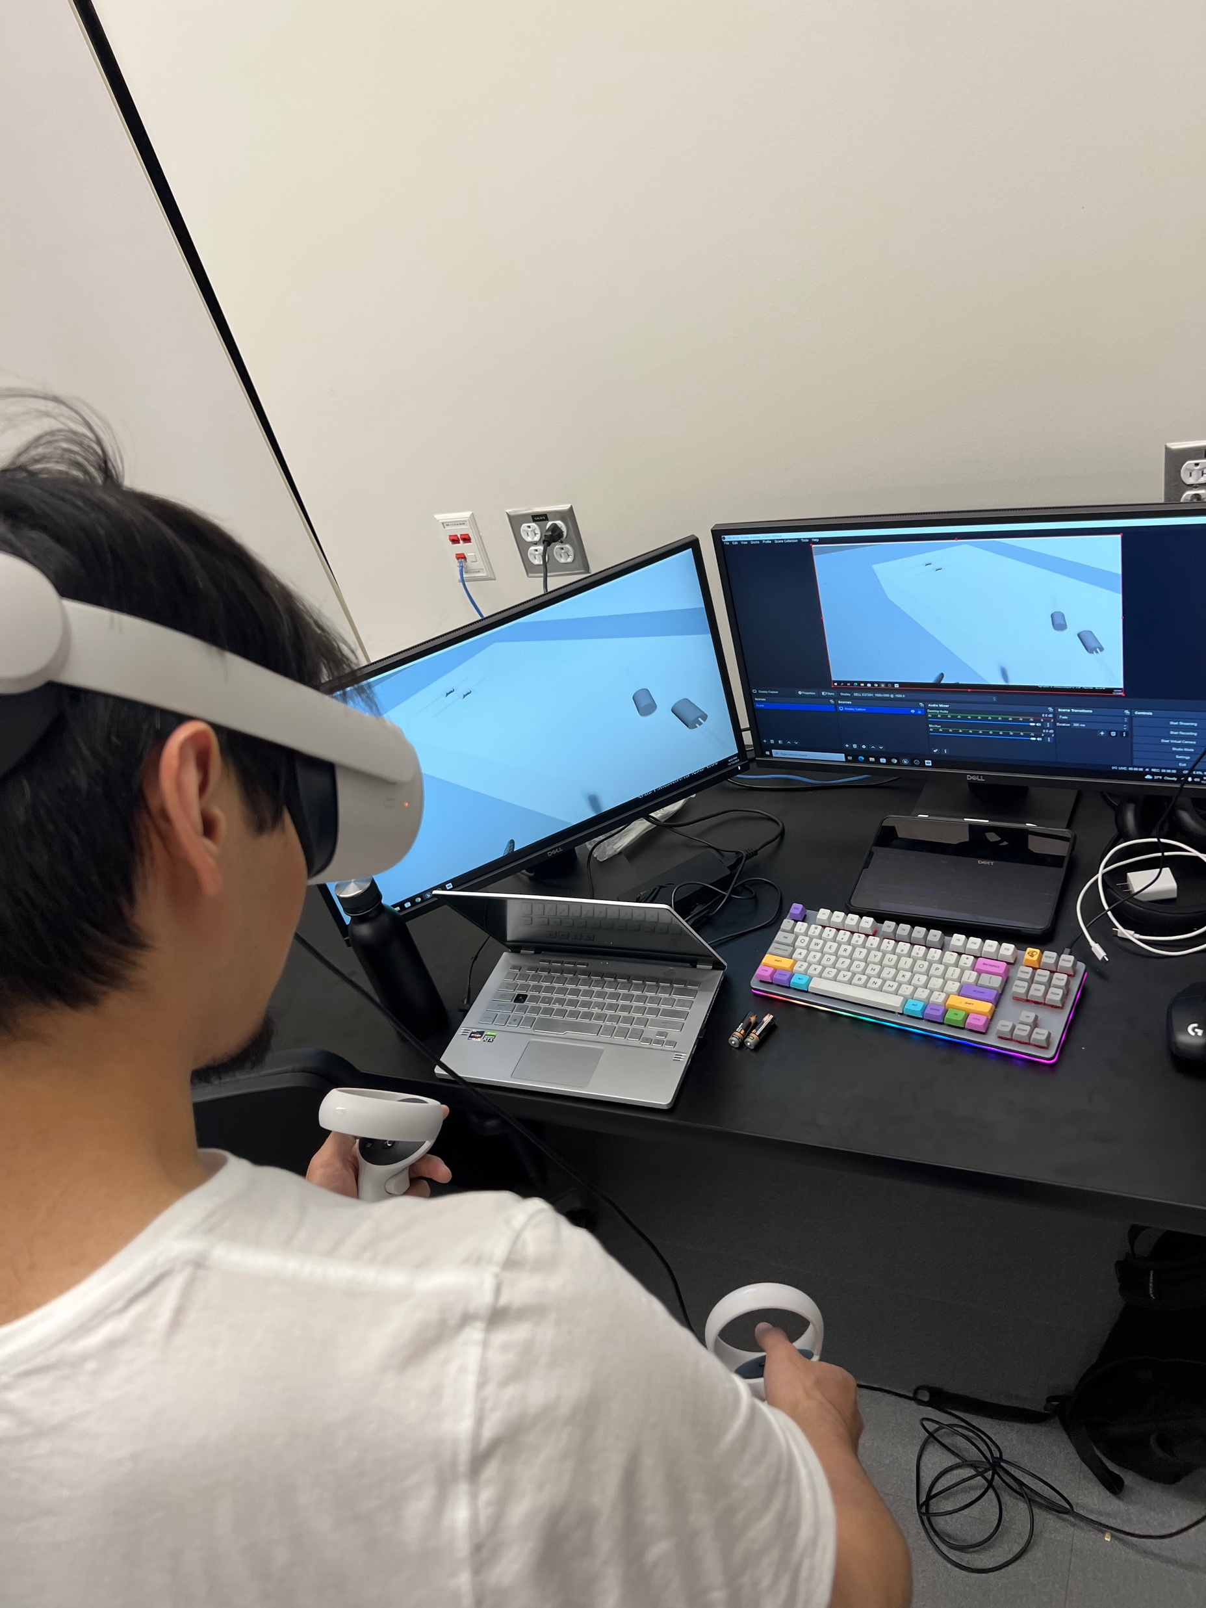
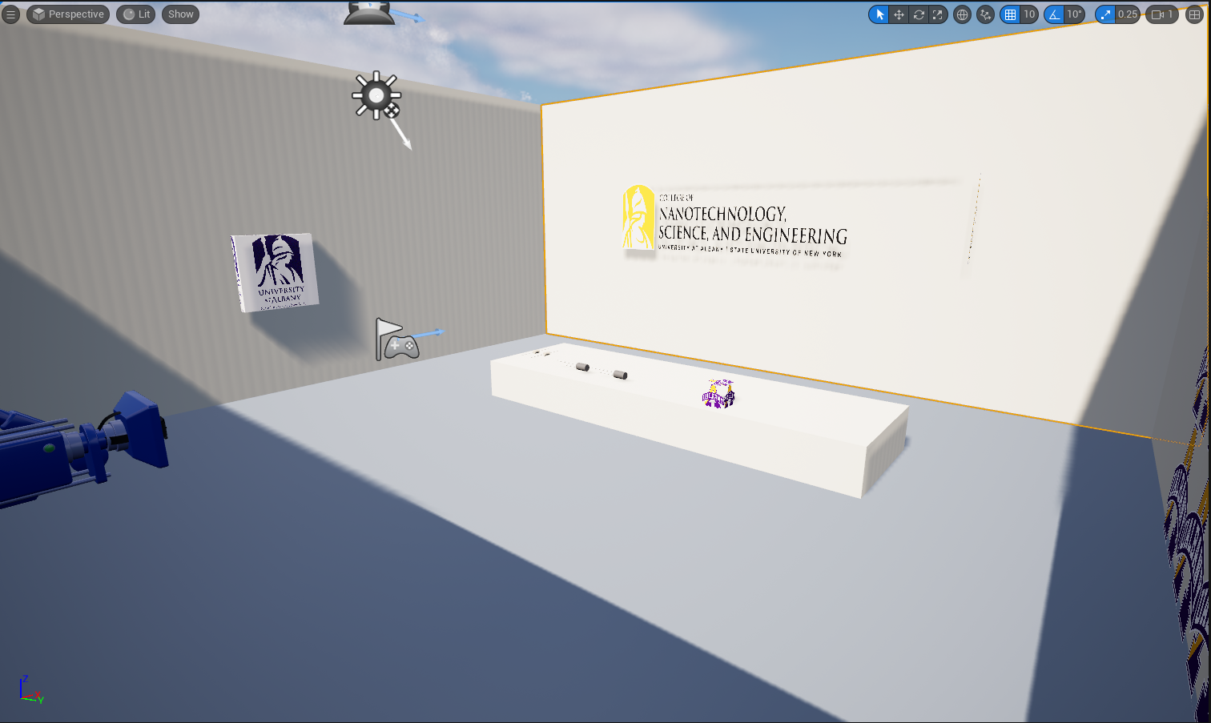
Introduction
COVID-era highlights the challenge of remote education
Piloting UAlbany’s first XR Lab
Immersive and Experiential Learning
XR FALL 2023
Notes:
*One of the challenges that has been identified during the COVID-era is teaching courses that have mandatory laboratory components. In such cases remote teaching and learning is a challenge.
*In an effort to integrate XR into laboratory-oriented classes, we need to develop a VR/AR learning platform for fundamental classes within the ECE curriculum.

